Slide 1
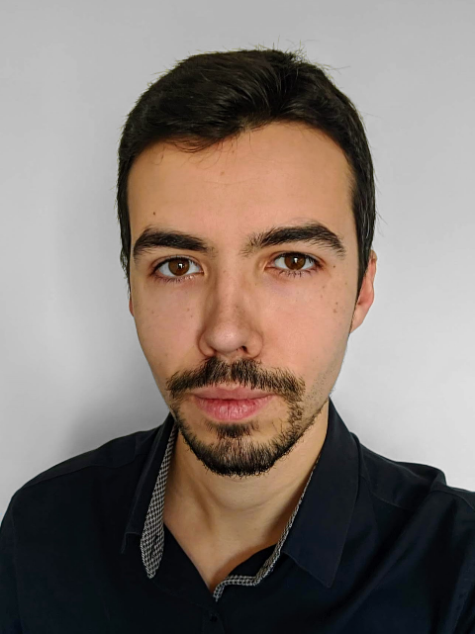

Jordi Mas Parramon
Hobbies
I like programming, playing videogames, listening to music and watching series and movies, but also playing sports, going out with friends, driving with music and climbing.
I developed a web, a portfolio showing my experience and my projects, such as the android apps and games I developed in my free time. Take a look! jordimas96.github.io
About me
Web programmer with 5+ years of experience
Occasional Android developer
I studied a Double Higher Degree Training Course in Web and Multiplatform Application Development in Montilivi Institute, Girona
I LOVE CSS and visual design
I was the main developer of a social network related to art, at In2art, where I was responsible for the frontend, design and part of the backend. I built the web page from scratch in Angular, CSS, and TypeScript
+34 6xxxxxx80
jordi.mas@evorait.com
LinkedIn: Jordi Mas
Notes:
Evora IT Solutions

